Slide 1


INGREDIENTS FOR A THRIVING AIRBNB

Slide 2

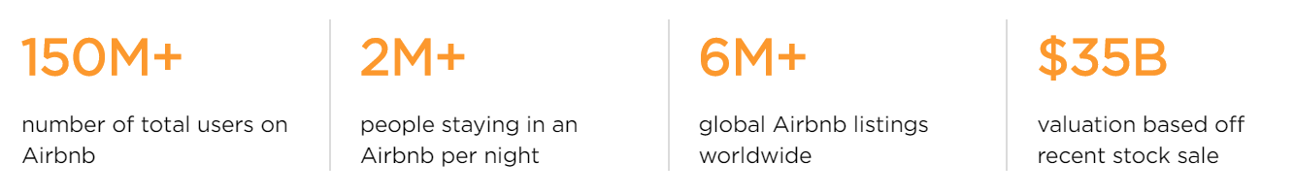
AirBnB is HUGE
Src: https://ipropertymanagement.com/research/airbnb-statistics
Airbnb offers listings in over 191 countries.
There are over 650,000 hosts worldwide.
The average per-night price for reservations is as affordable as $80.

Slide 3
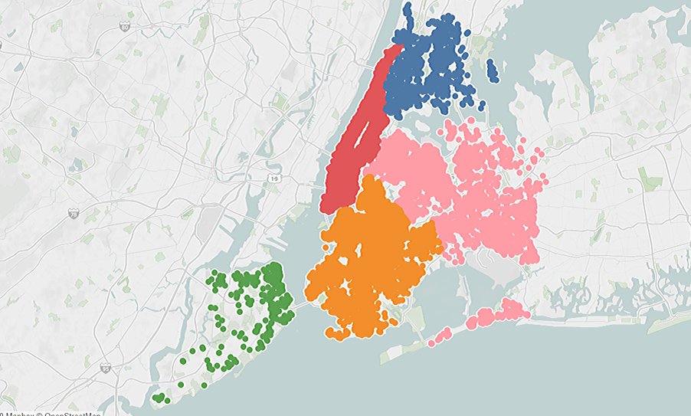
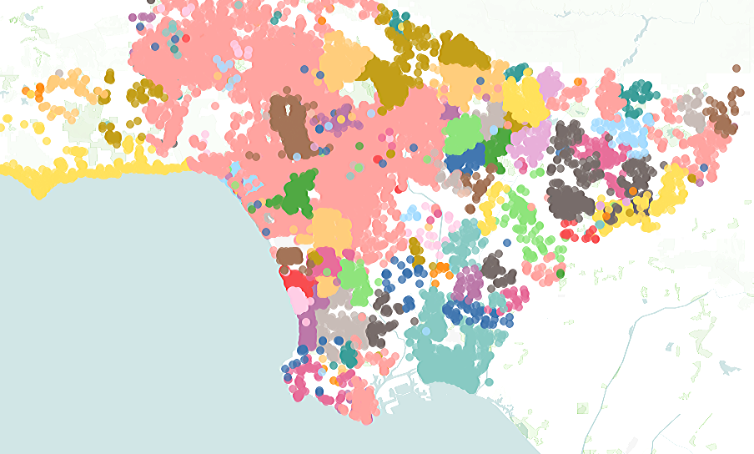
THE MAIN QUESTION IS
IN THIS CROWDED AIRBNB SPACE...
HOW DO YOU STAND OUT?

Slide 4

We have divided this presentation into 3 distinct parts
HOST ATTRIBUTES
What makes you the perfect host for your demanding guests?
LOCATION ATTRIBUTES
03
Where should your AirBnB be located in order to gain the maximum moolah?
COST ATTRIBUTES
It is super important to price your AirBnB right or else it might get ignored real easily!

Slide 5

HOST ATTRIBUTES

Slide 6

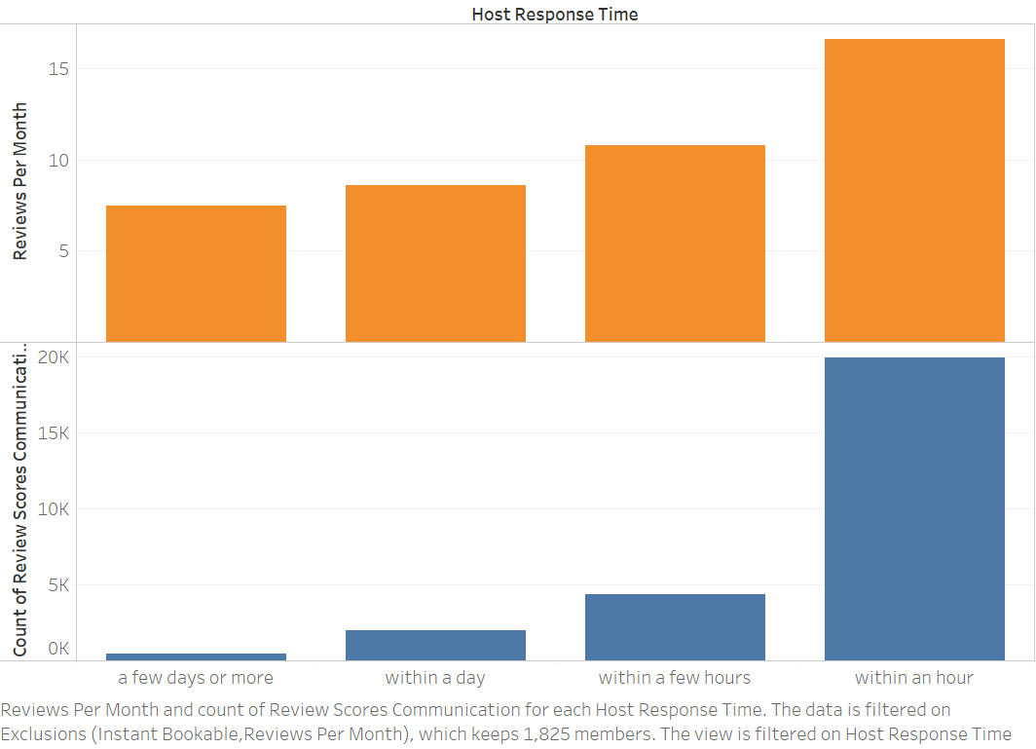
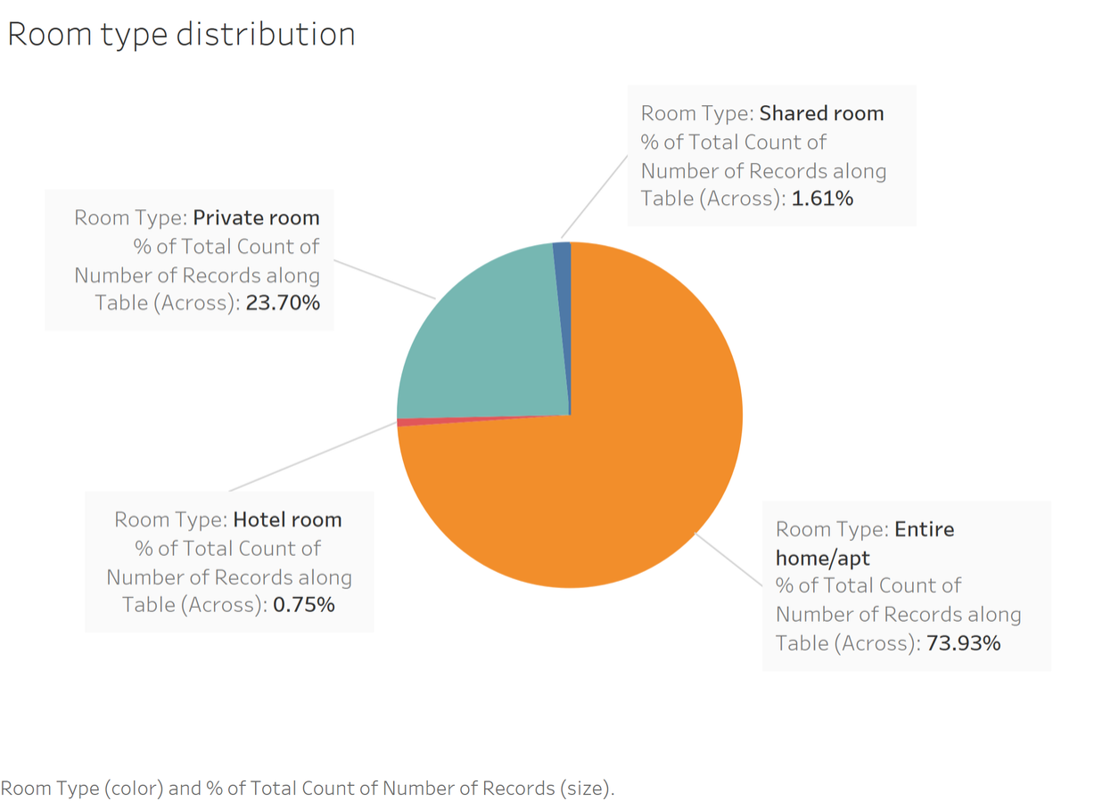
H
O
S
T
A
T
T
R
I
B
U
T
E
S
REPLY WITHIN AN HOUR
BE READY TO GIVE OUT YOUR ENTIRE APARTMENT!

Slide 7
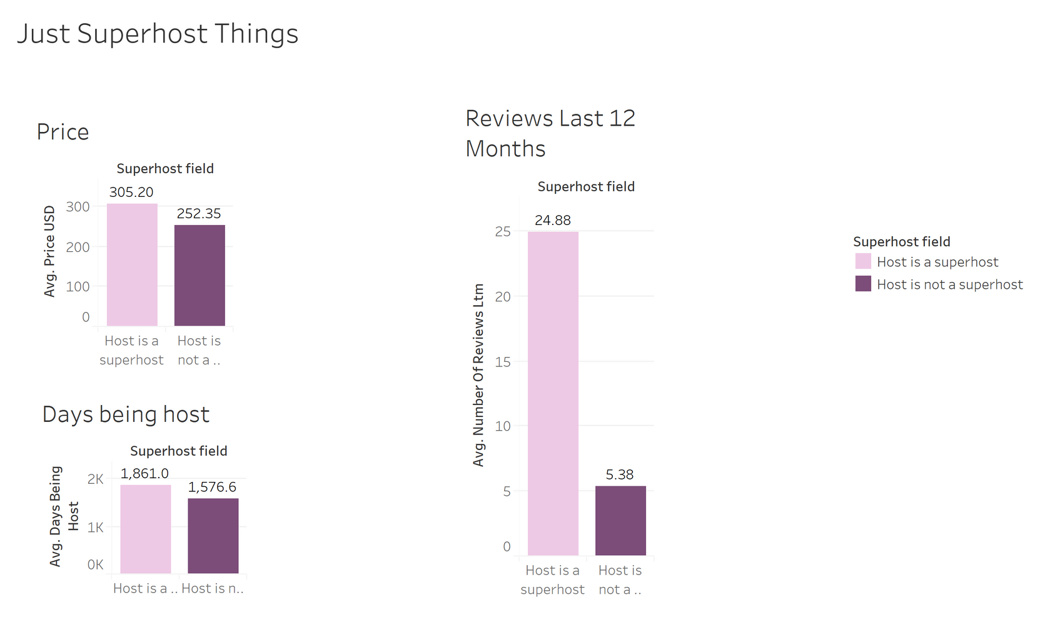
H
O
S
T
A
T
T
R
I
B
U
T
E
S
BEING SUPER HELPS!

Slide 8
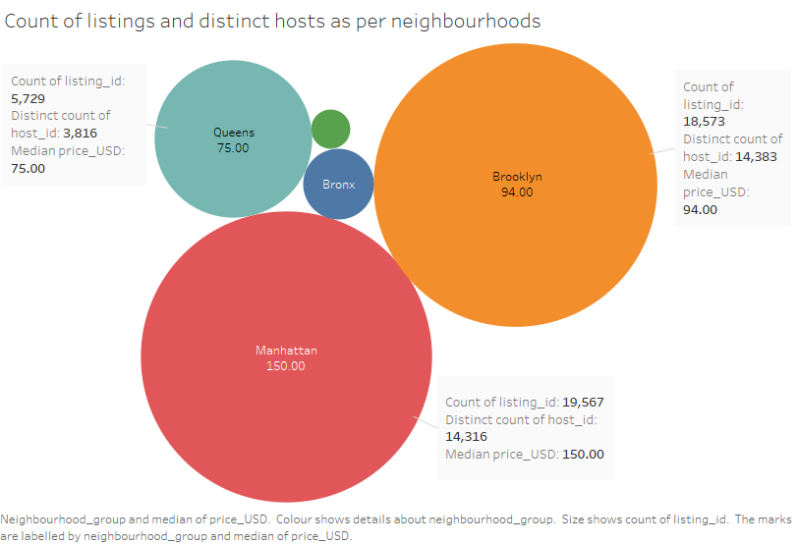
H
O
S
T
A
T
T
R
I
B
U
T
E
S
LOCATION OF LISTING MATTERS!

Slide 9
LOCATION ATTRIBUTES

Slide 10
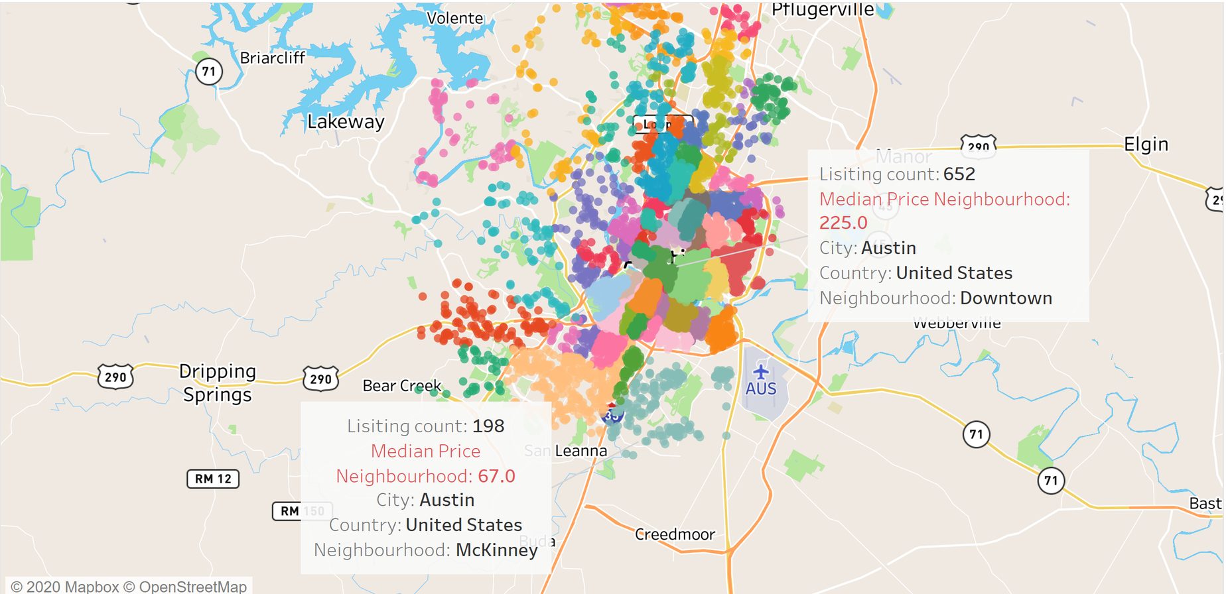
L
O
C
A
T
I
O
N
A
T
T
R
I
B
U
T
E
S
THERES A BIG DIFFERENCE IN MEDIAN PRICE BASED ON LOCATION

Slide 11
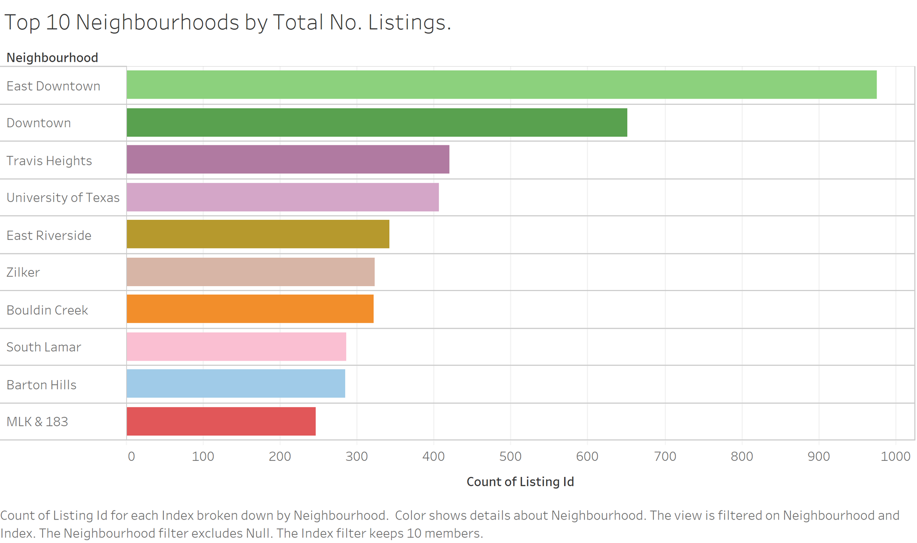
L
O
C
A
T
I
O
N
A
T
T
R
I
B
U
T
E
S
COMPETITION IS HIGH IN DOWNTOWN!

Slide 12
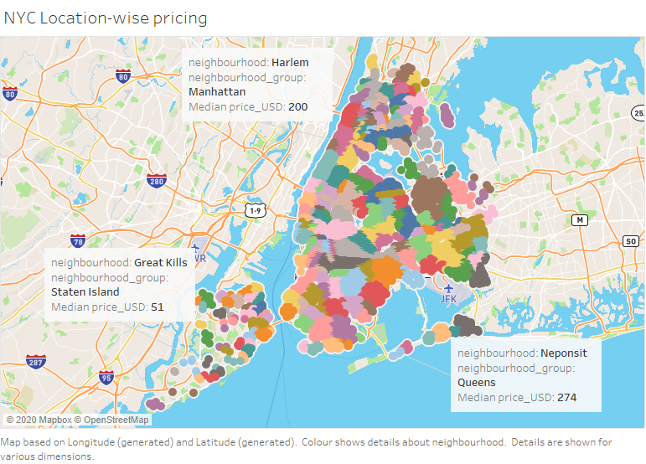
C
O
S
T
A
T
T
R
I
B
U
T
E
S

Slide 13
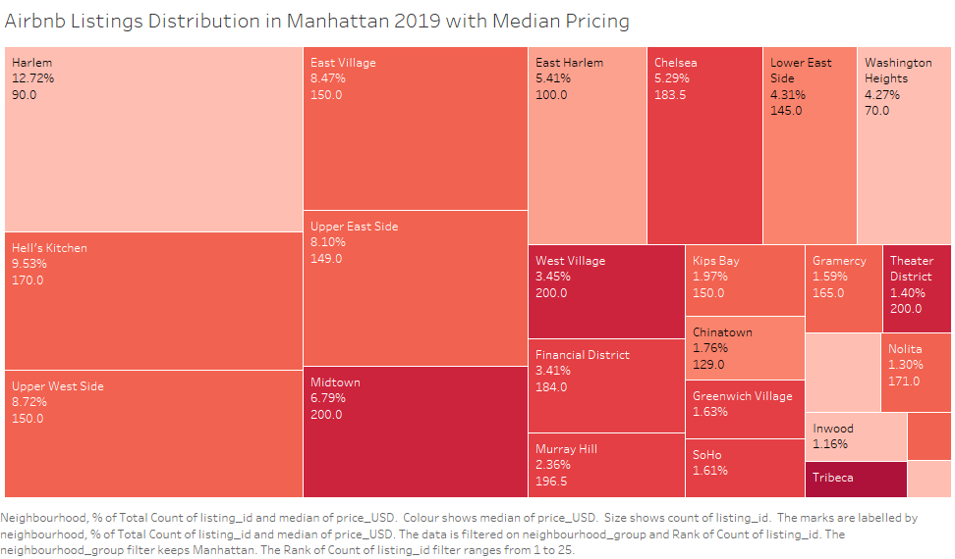
L
O
C
A
T
I
O
N
A
T
T
R
I
B
U
T
E
S

Slide 14
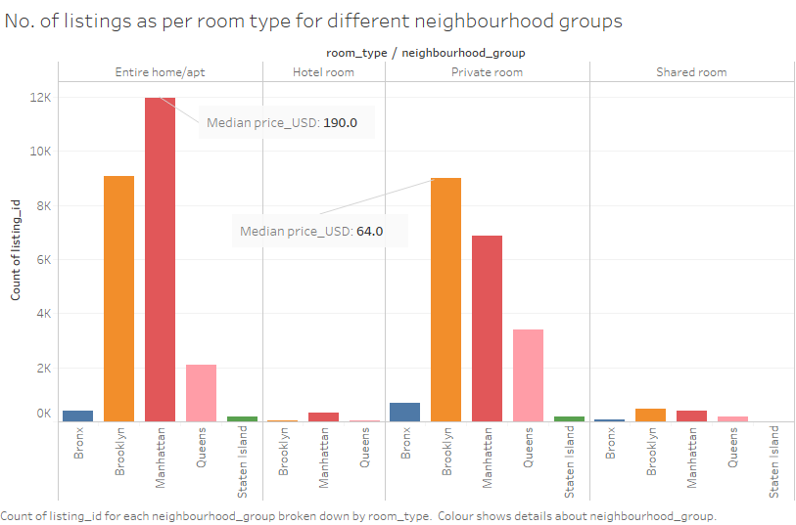
L
O
C
A
T
I
O
N
A
T
T
R
I
B
U
T
E
S

Slide 15
COST ATTRIBUTES

Slide 16
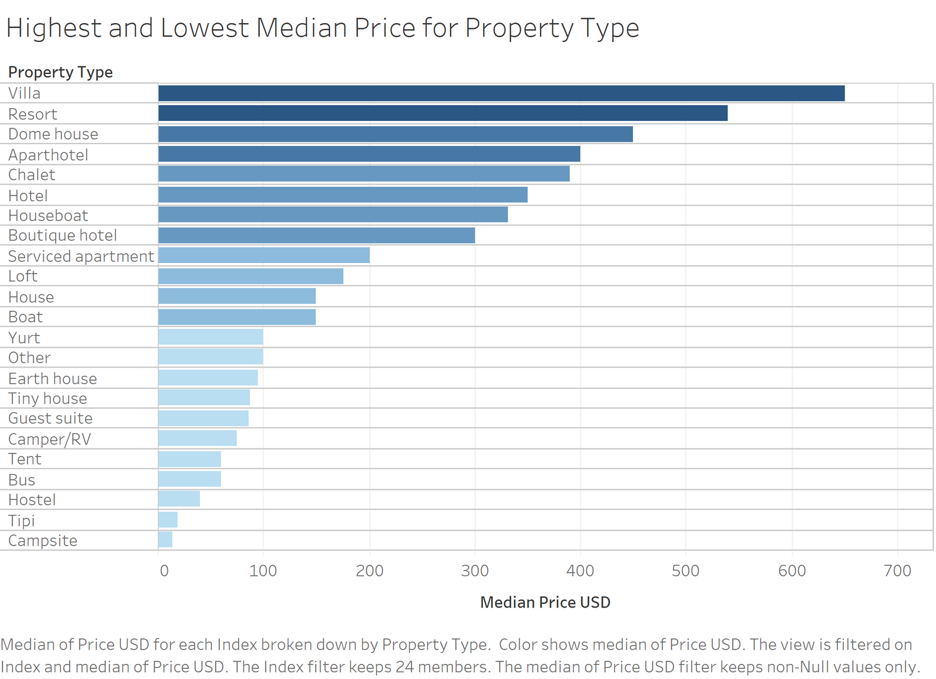
C
O
S
T
A
T
T
R
I
B
U
T
E
S
PRICE IT RIGHT!

Slide 17
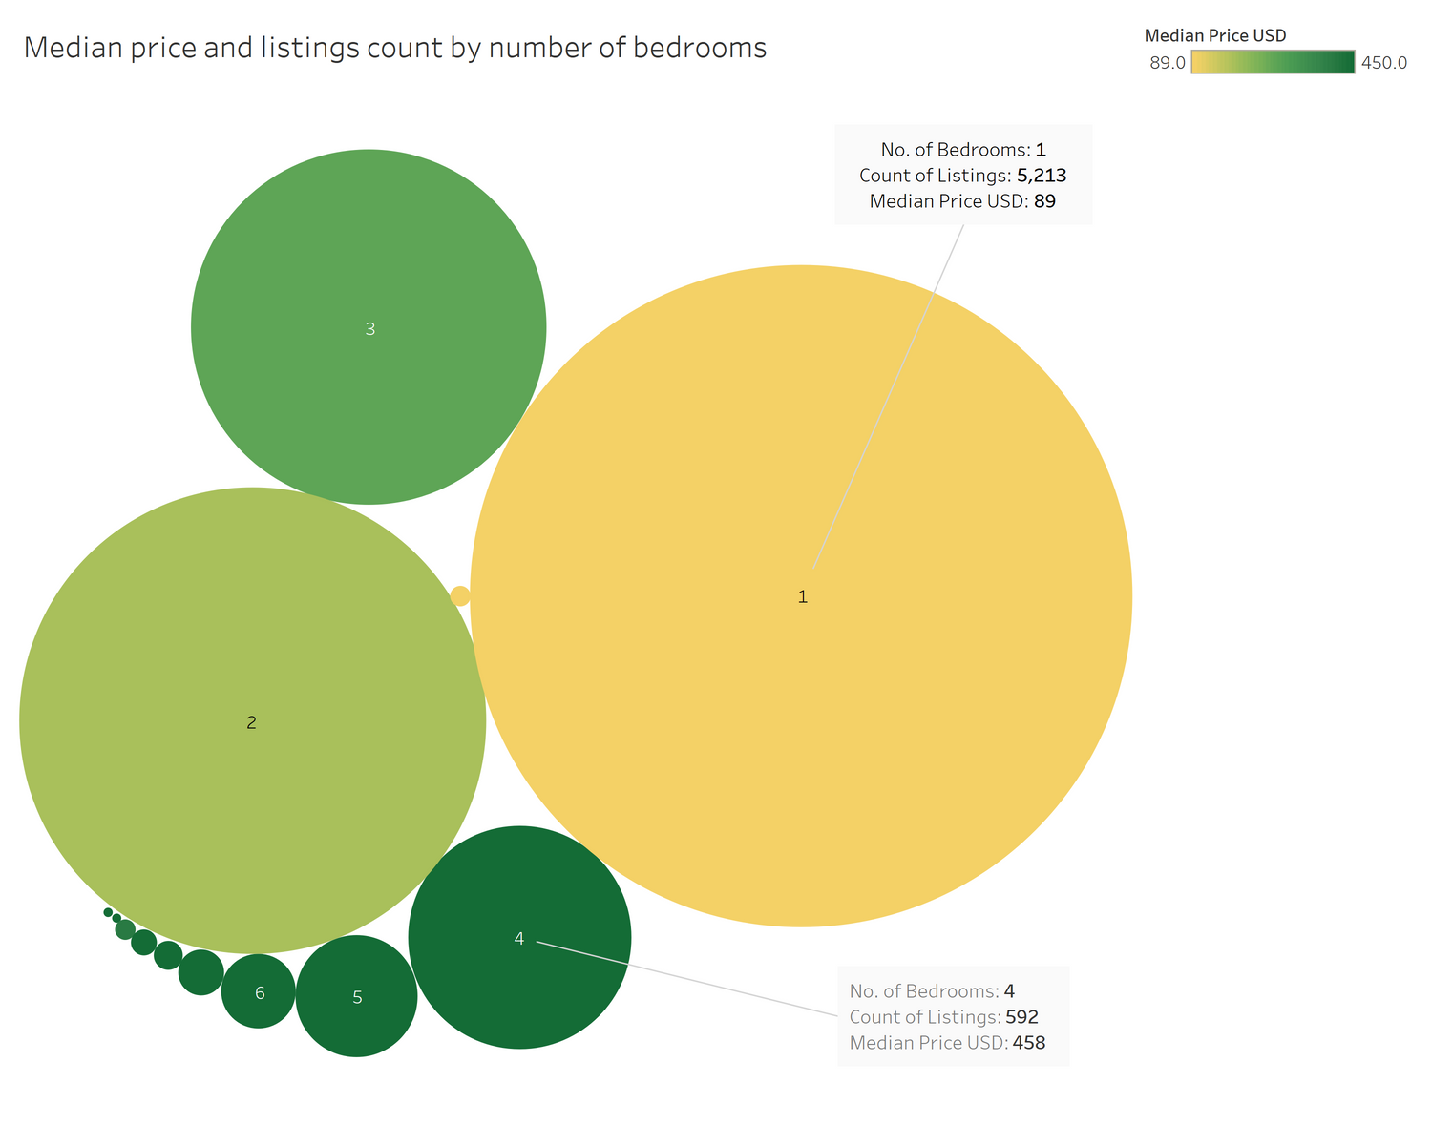
C
O
S
T
A
T
T
R
I
B
U
T
E
S
PRICE IS DIRECTLY PROPORTIONAL TO SPACE

Slide 18
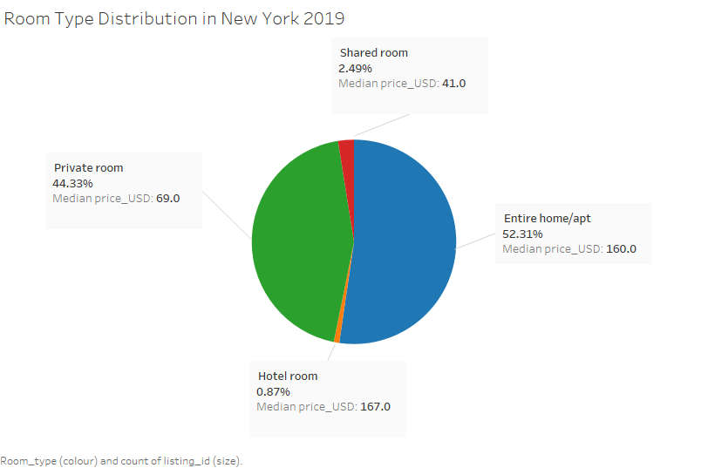
C
O
S
T
A
T
T
R
I
B
U
T
E
S

Slide 19
NEW YORK VS AUSTIN

Slide 20
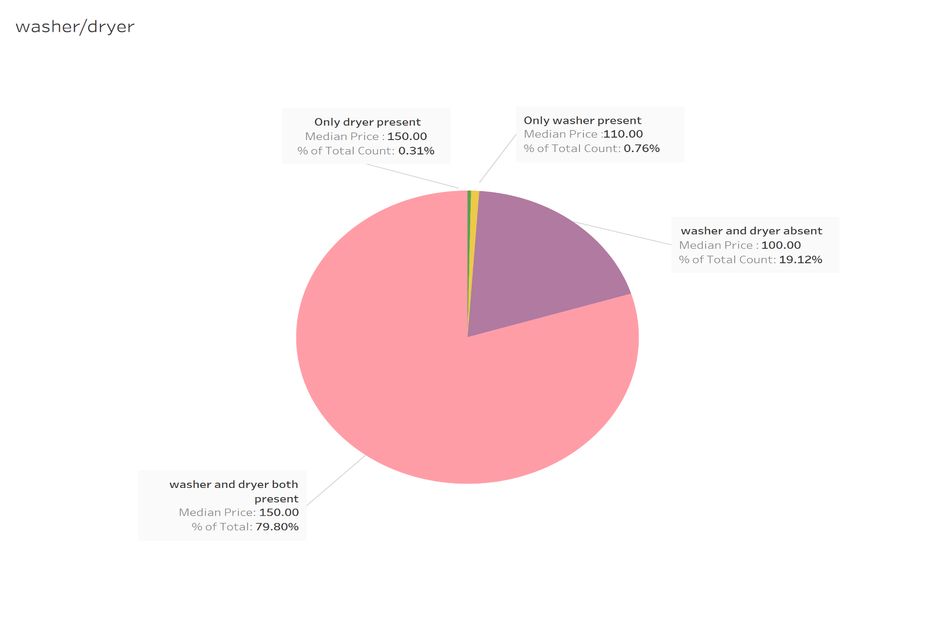
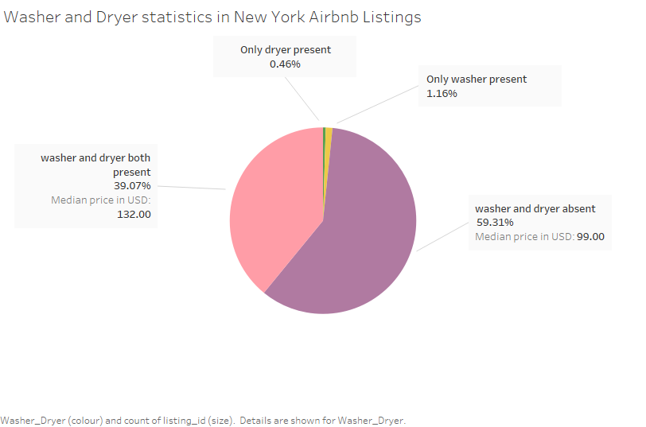
AUSTIN
NEW YORK
AMENITIES CAN CAUSE MASSIVE FLUCTUATIONS IN MEDIAN PRICE

Slide 21
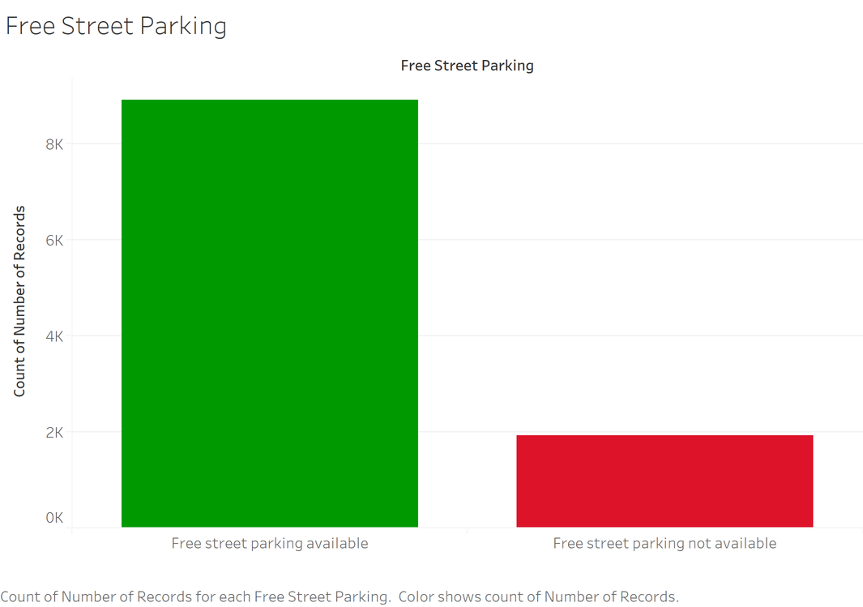
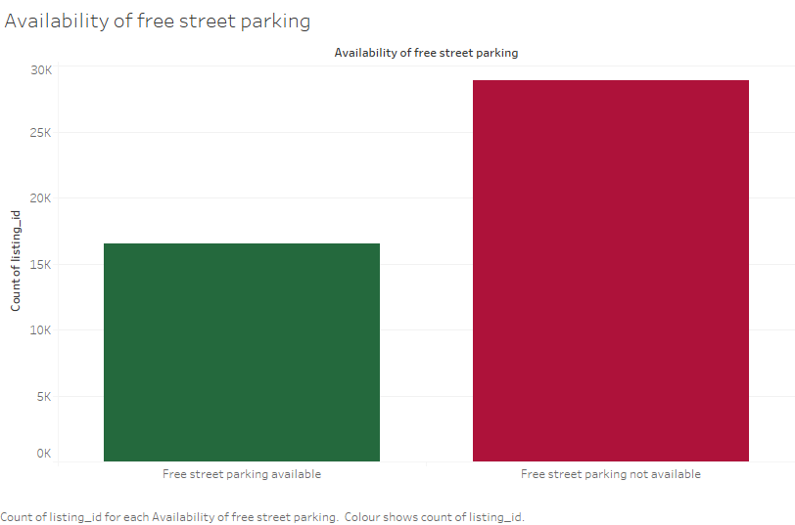
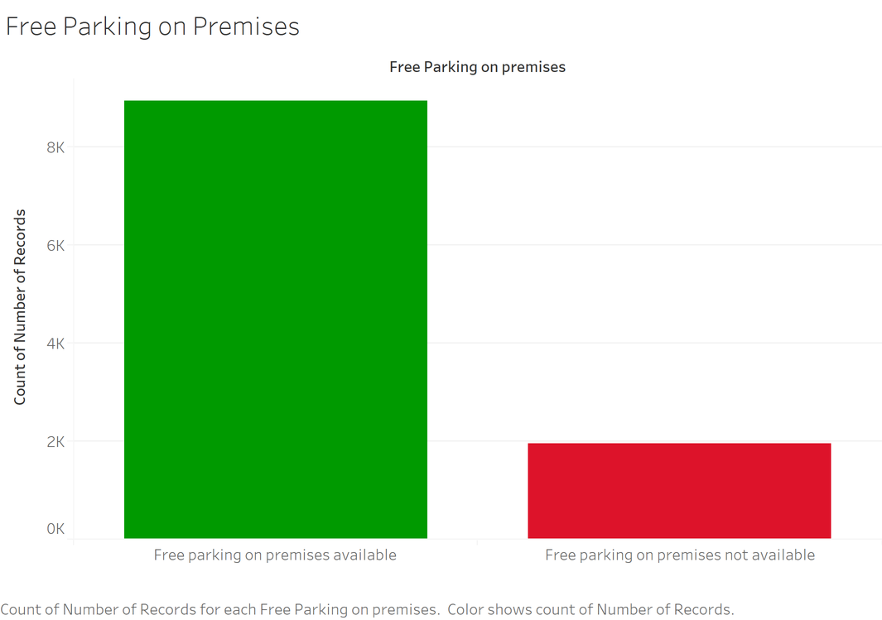
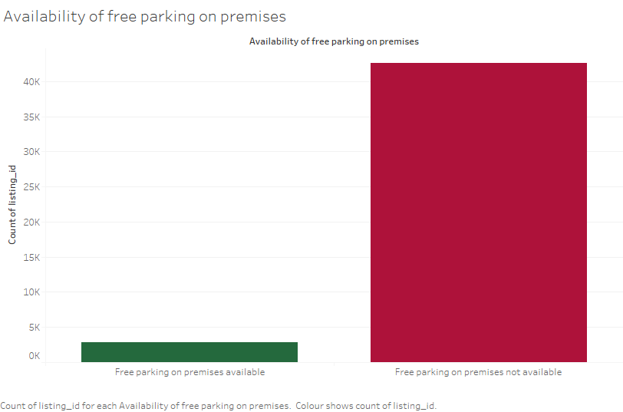
N
E
W
Y
O
R
K
A
U
S
T
I
N
V
S

Slide 22
ANALYSIS

Slide 23
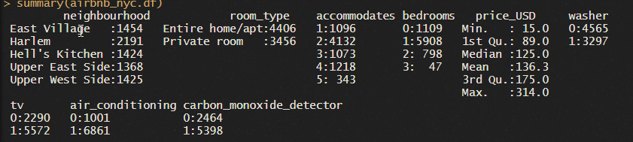

Slide 24
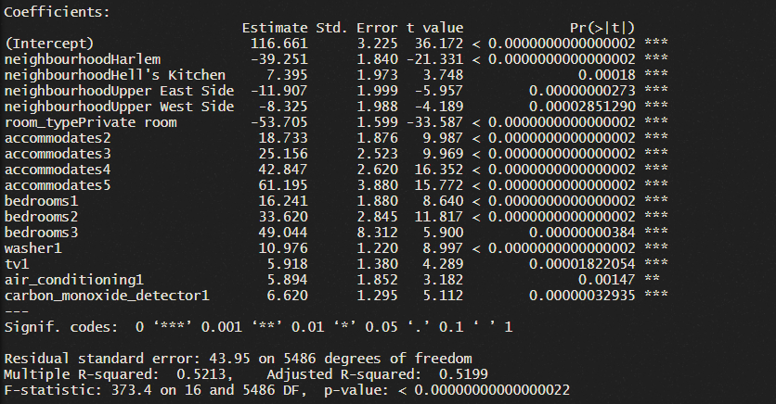
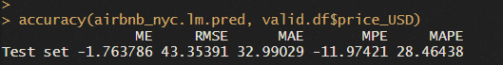

Slide 25

CONCLUSION

Slide 26


PRICE IT RIGHT
LOCATION IS KEY
Be sure to check market trends to get the best out of your BnB
Make sure to be just near the city centre, but not too much!
THE MAGIC INGREDIENTS
COMMUNICATION MATTERS
JUST DO IT
Remember, opportunity never knocks twice. Grab it while it lasts!
The faster you connect with your guests, the better your chances of success

Slide 27

END

